Slide 1
Understanding Request Pickup Locations
and Library Relations
Yoel Kortick

Slide 2
Agenda
  Introduction
  A specific example
  Why these specific Pickup Locations appear
  Library Relations
  Two important related comments
2

Slide 3
Introduction

Slide 4
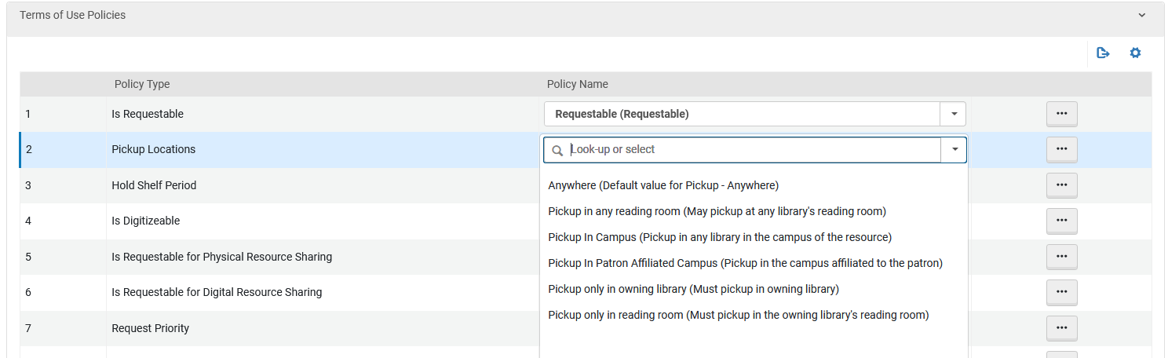
Introduction
There are various options to define for the "Pickup Locations" in the terms of Use (TOU) of type "Request".
TOUs of type "Request" are visible at "Configuration > Fulfillment > Physical Fulfillment > Terms of Use and Policies" then filter by "Terms Of Use Type: Request"

Slide 5
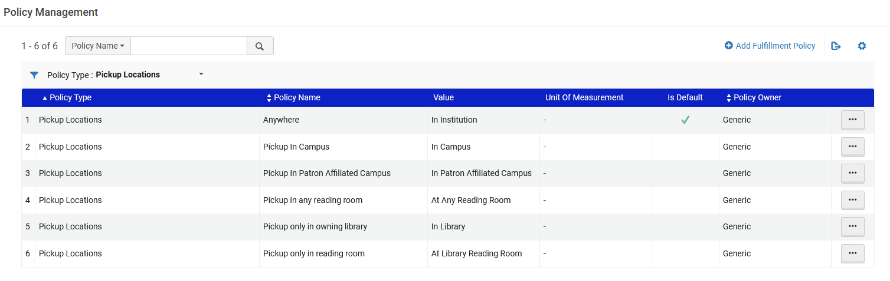
Introduction
These "Pickup Locations" are defined as "Advanced Policy Configurations" of type "Pickup Locations"
Advanced Policy Configurations of type "Pickup Locations" are visible at "Configuration > Fulfillment > Physical Fulfillment > Advanced Policy Configuration" then filter by "Policy Type: Pickup Locations"

Slide 6
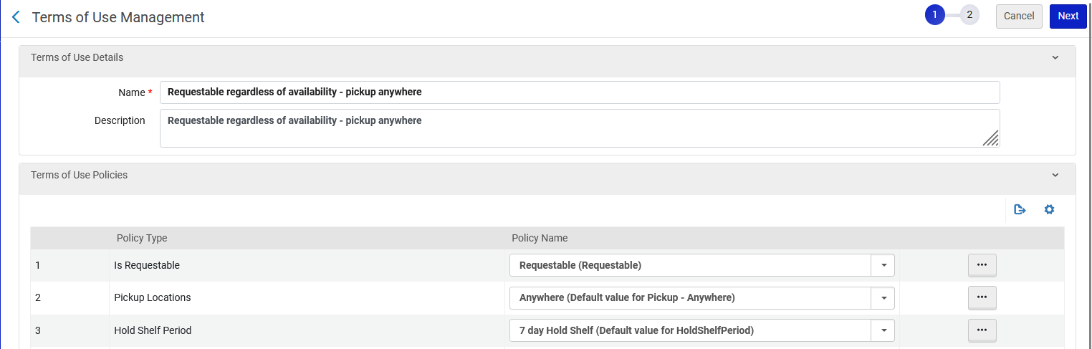
Introduction
In this presentation we will be focusing specifically on understanding the Policy Type "Pickup Locations" with value "Anywhere".
This exists for example in TOU "Requestable regardless of availability - pickup anywhere"

Slide 7
A specific example

Slide 8
A specific example
We will now look at a specific example, and this will help us to understand the request pickup locations and the library relations.
We will make a request for these two items and see what the possible pickup locations are:
Title "Women's movements in twentieth-century Taiwan" Barcode: AU66665
  Item is in "Main Library" "General" Location.
Title "Librarianship in Taiwan" Barcode: AU66684
  Item is in "Library and Information Science Library" "Open Stacks".

Slide 9
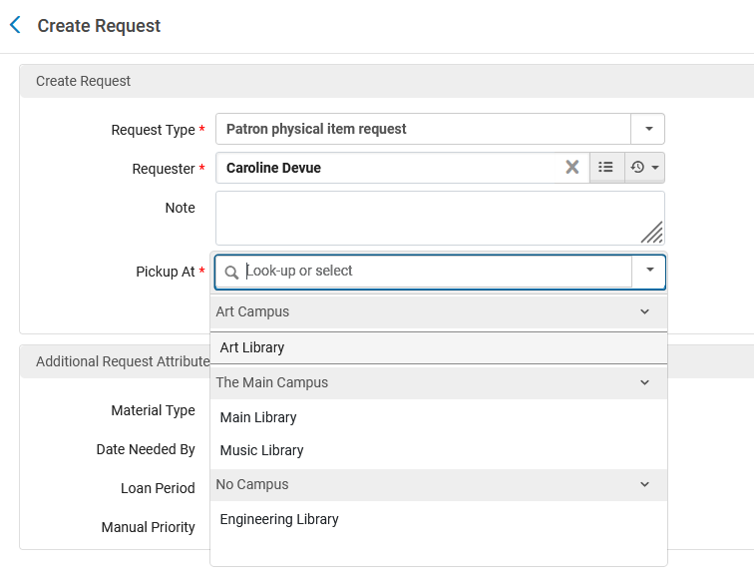
A specific example
When requesting the item in "Main Library" "General" Location the possible pickup locations are as follows: Art Library, Main Library, Music Library and Engineering Library

Slide 10
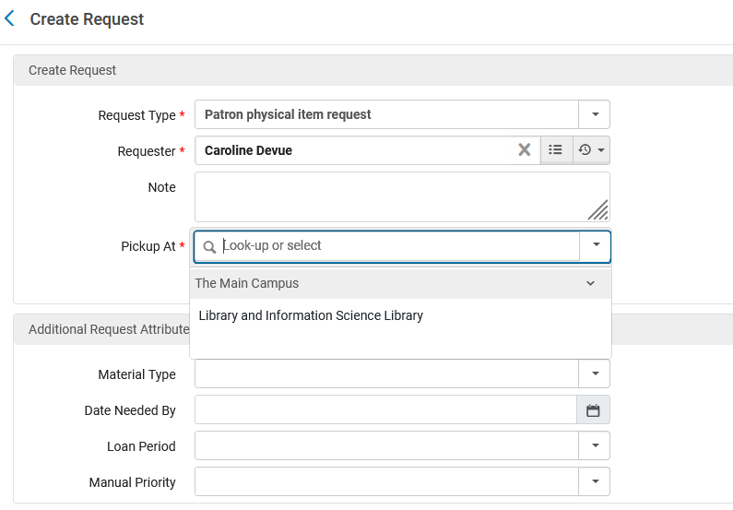
A specific example
When requesting the item in "Library and Information Science Library" "Open Stacks" Location the possible pickup locations are as follows: Library and Information Science Library

Slide 11
Why these specific Pickup Locations appear

Slide 12
Why these specific Pickup Locations appear
Let’s see now why these specific pickup locations appear.
In both cases (for item in Main Library and for item in Library and Information Science Library) the TOU which was being used is "Requestable regardless of availability - pickup anywhere"
This can be seen by using the "Fulfillment Configuration Utility" at "Fulfillment > Advanced Tools – Loans > Fulfillment Configuration Utility"
This TOU has "Pickup Locations" defined as "Anywhere"
This is evident on the next slide

Slide 13
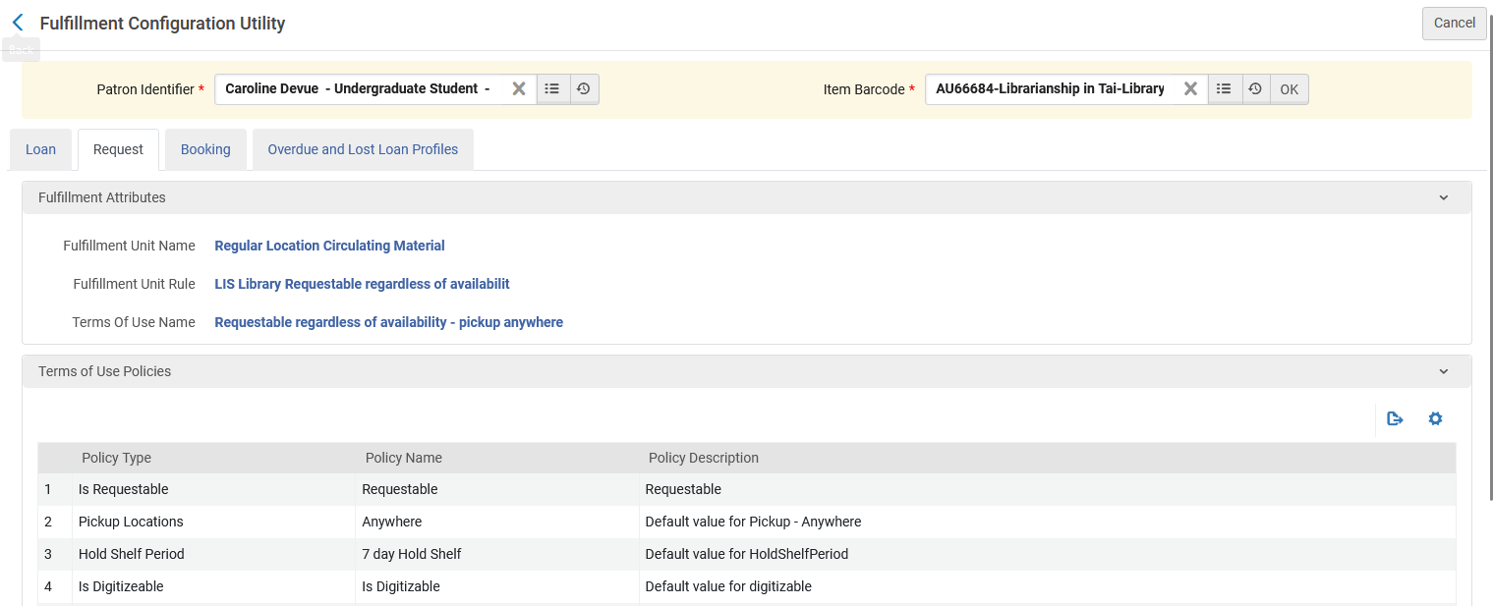
Why these specific Pickup Locations appear
The TOU and definition of the Pickup Locations

Slide 14
Why these specific Pickup Locations appear
Someone might ask as follows:
  If the "Pickup Locations" is defined as "Anywhere", then how come I do not see all libraries listed as possible pickup locations? We said "anywhere" so how come we do not see "any library"?
  How come when we requested the item in the Main Library, we saw only these libraries: Art Library, Main Library, Music Library and Engineering Library ?
  How come when we requested the item in the Library and Information Science Library, we saw only these libraries: Library and Information Science Library?
The answer is
  When it states "Pickup Locations" = "Anywhere" it actually means "Anywhere which is defined with value "Deliver To" in the corresponding "Library Relations""

Slide 15
Library Relations

Slide 16
Library Relations
The reason different libraries appear as pickup locations for each of these options has to do with the library relations.
For the "Library and Information Science Library" there are no relations
  This means that the only possible pickup location is "itself" (The Library and Information Science Library).
For the "Main Library" there are relations as follows: The "Main Library" can "deliver to" the Music Library, Art Library and Engineering Library".
  Therefore, these libraries were seen as pickup locations when creating the request.
  There is also the possible pickup location of "itself" (The Main Library).

Slide 17
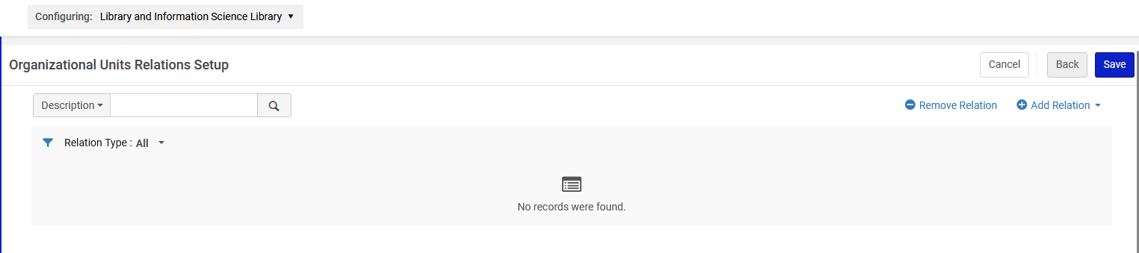
Library Relations
Let’s check the Library Relations for "Library and Information Science Library"
This can be seen by doing "Configuration > On top select "Library and Information Science Library" > Fulfillment > Library Management > Relationships
There are no relations and thus the only possible pickup location is "itself".

Slide 18
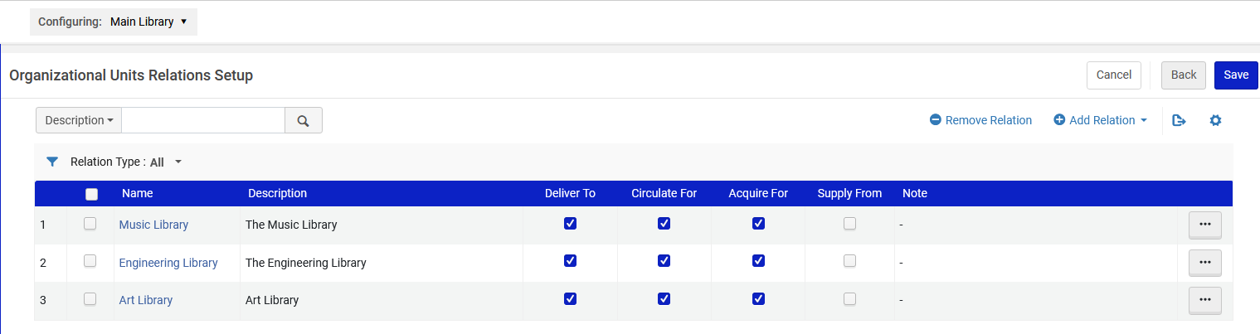
Library Relations
Let’s check the Library Relations for "Main Library"
This can be seen by doing "Configuration > On top select "Main Library" > Fulfillment > Library Management > Relationships"
There are relations of type "Deliver To" for Music Library, Art Library and Engineering Library" and therefore, these were the Pickup Location options (in addition to "itself").

Slide 19
Library Relations
See also: Configuring Fulfillment Services Between Libraries Within an Institution
There it states: Deliver to (available on the library level only) – The library that you are configuring is able to deliver requested items to the specified library.

Slide 20
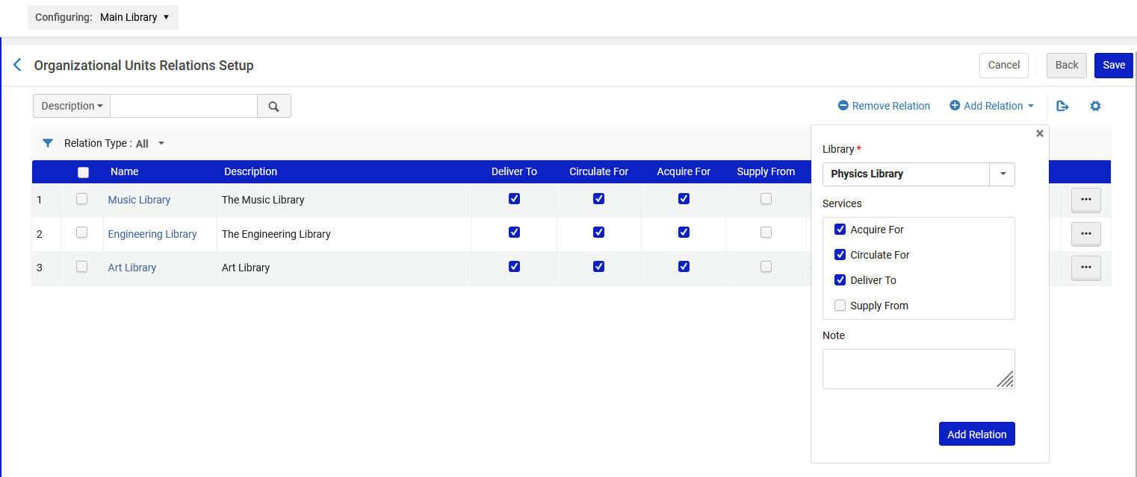
Library Relations
As a test, we will now add "Physics Library" with relationship "Deliver To" for the "Main Library"

Slide 21
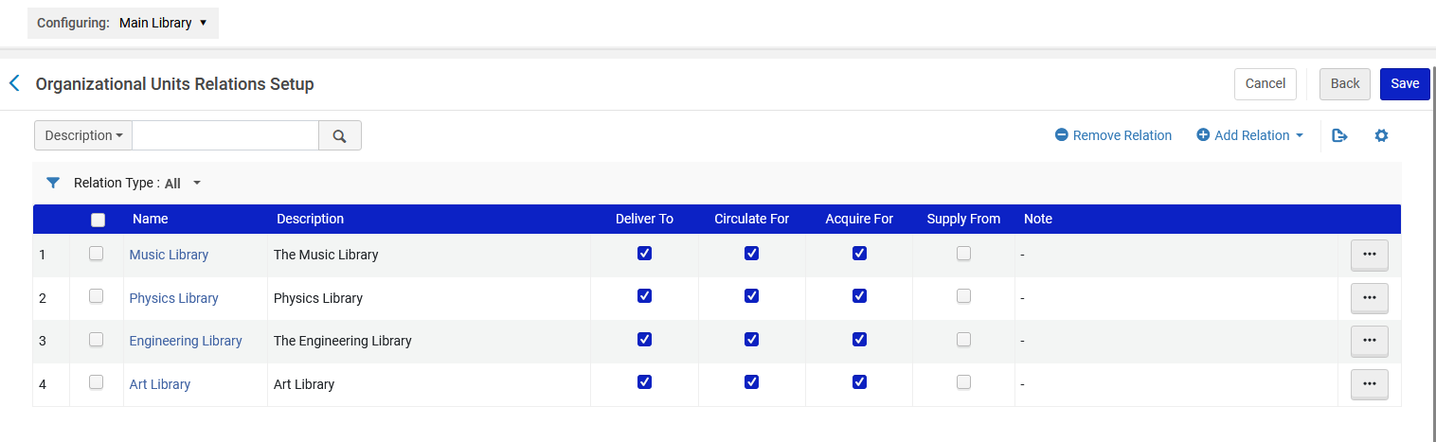
Library Relations
The new relationship "Physics Library" with relationship "Deliver To" has been added for the "Main Library"

Slide 22
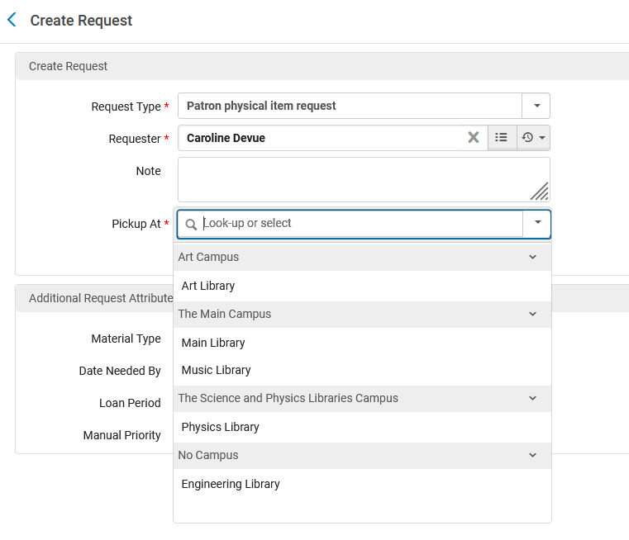
Library Relations
Now Physics Library also appears as a Pickup Location when requesting an item from Main Library.
This is because "Pickup Locations = Anywhere" is in the corresponding TOU and "Physics Library" was added with a "Deliver To" attribute to the Library Relations of the Main Library

Slide 23
Two important related comments

Slide 24
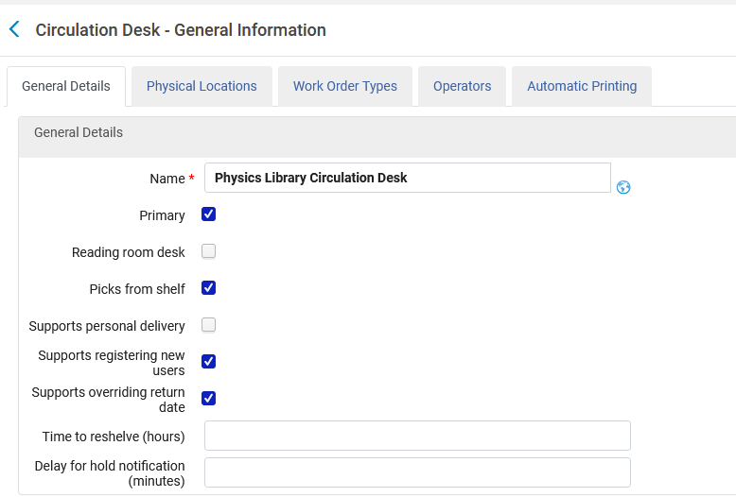
Two important related comments
When we added the "Physics Library" to the "Library Relations" of the "Main Library" with attribute "Deliver To" this was actually not enough to determine that the "Physics Library" would appear as a pickup location when creating a request for an item in the Main Library.
We also need to ensure that the library which will be a "Pickup Location" (in this case the "Physics Library" will also have a circulation desk defined as "Primary"

Slide 25
Two important related comments
As described at Configurating Circulation Desks, "Primary" means "circulation desk can perform check-out and check-in services for another library".
Therefore, if this is not checked for the "Physics Library" then the "Physics Library" will not appear as a request Pickup Location for an item which is in the "Physics Library"

Slide 26
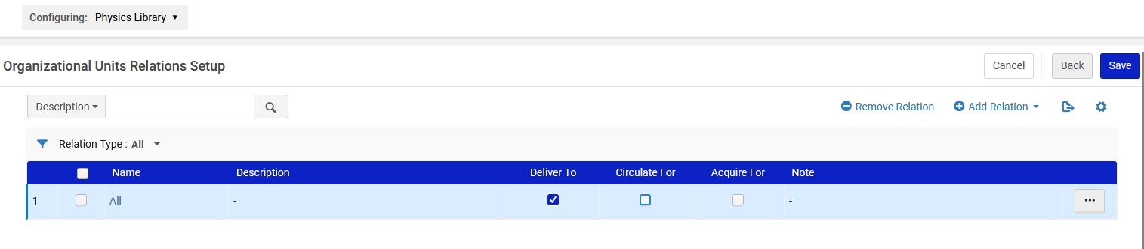
Two important related comments
Additionally, it is "logical" that each of the libraries which can be a "Pickup Location" will also have defined that they can "Circulate For" the library of the item.
For example, if we were to have the following in the Physics Library it would mean that the item from the Main Library can be delivered there but not loaned.
Now "Circulate For" is not checked
We are defining for "All" libraries instead of each specific one with different definitions. This is not related to our specific issue, but we are in any case pointing out this possibility.

Slide 27
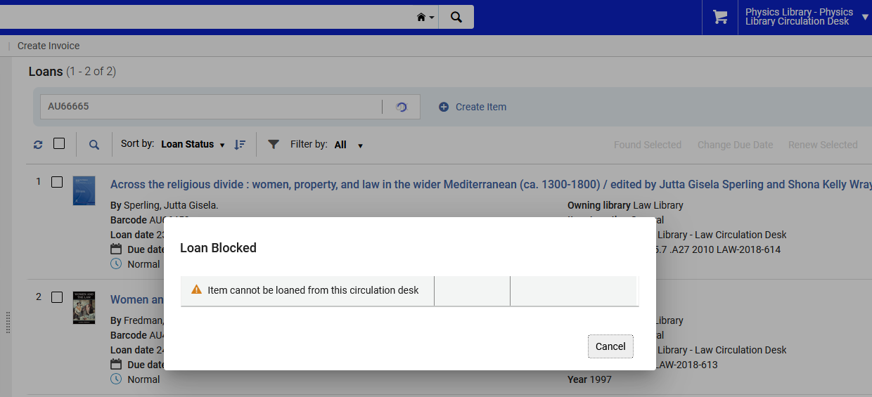
Two important related comments
We would get this result when trying to loan an item from the Main Library at the Physics Library.

Slide 28
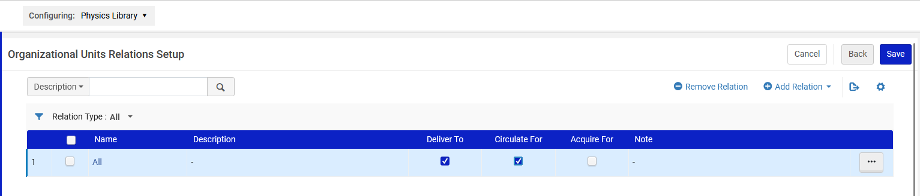
Two important related comments
However, if we were to have the following in the Physics Library it would mean that the item from the Main Library can be delivered there and also loaned.
Now "Circulate For" is checked

Slide 29
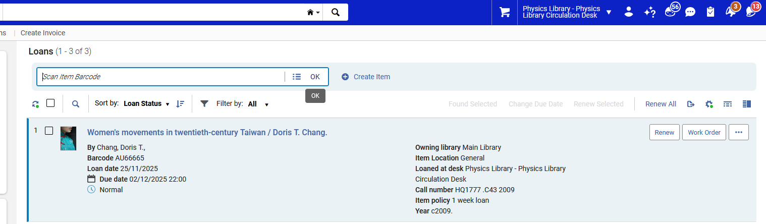
Two important related comments
Now we can loan the item from the Main Library while at the Physics Library (we can loan it from the Physics Library and not only "Deliver To" the Physics Library).

Slide 30
Thank You

